Slide 1
Final Project Presentation
Team FHIR When Ready
Joshua Kaelin | Reece Karge | Paul Maserrat

Slide 2
The Plan
Build a Clinical Decision Support App
Utilize the SMART-on-FHIR JavaScript framework
Use Cerner’s infrastructure (SMART/Oauth & FHIR resources)
Apply a mathematical model to queried FHIR data to generate a recommendation
Serve recommendation on UI

Slide 3
The Research
Our Organization mentors were comprised of experts in various fields that came together to create the vision for this SMART on FHIR app
We leveraged their robust knowledge of the clinical situational space to understand user needs
We leveraged a reference mathematical model created in Excel that was able to calculate risks based on patient observations over a time period

Slide 4
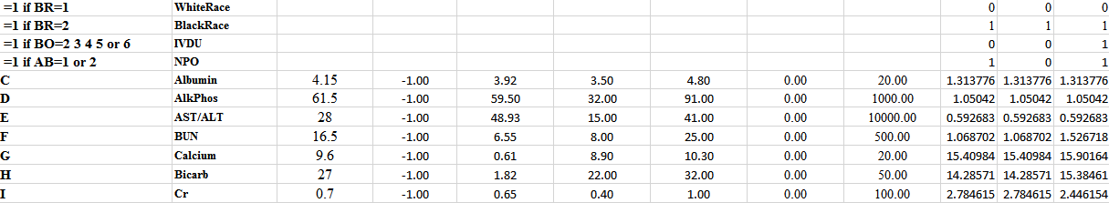
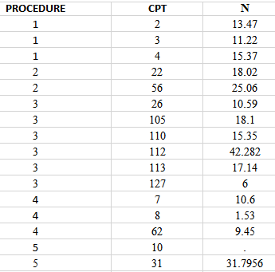
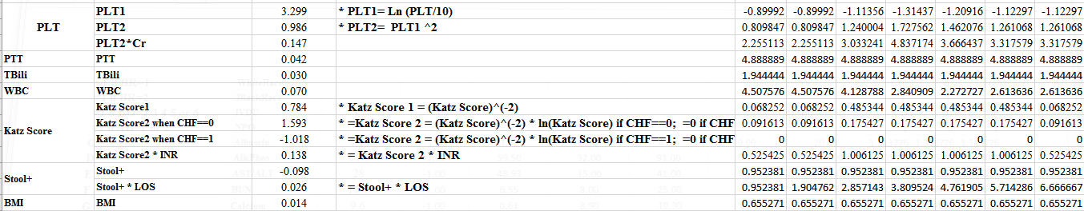
A peek into the model

Slide 5
The Problems
FHIR data availability
The mathematical model used for recommendation requires a multi-day period of observations
Many of the required variables are simply not present in bulk (if at all) on the FHIR server
There was some hope that Emory would have their own FHIR server available with this data that we could use but it did not pan out in time
Adjusted Framework
Our OM’s determined that they needed a Java Web Server application instead of a client-based JavaScript application

Slide 6
The New Plan
Develop a basic SMART-on-FHIR server-based application in Java
Publish application on Cerner’s developer portal
Prioritize OAuth functionality
Connect to Cerner’s FHIR server
Develop a hand-off document to replace our developer keys with our OM’s production keys at some future date
Build some UI that can be tested (retrieving one or more resources from the FHIR server)

Slide 7
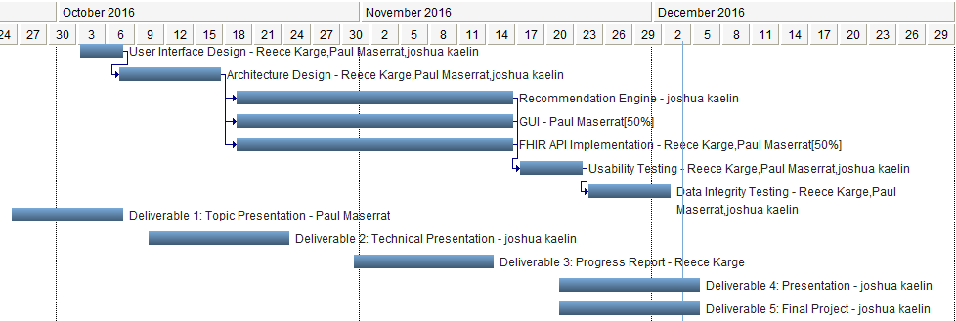
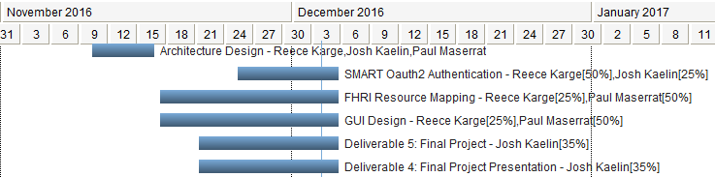
Gantt Changes
Original Plan
Starting Over

Slide 8
Modified Design
Server-based application changes SMART-on-FHIR integration
The SMART app changes from a Public App profile to a Confidential App profile.
Java Web App
User Interface
HAPI FHIR
OAuth Integration

Slide 9
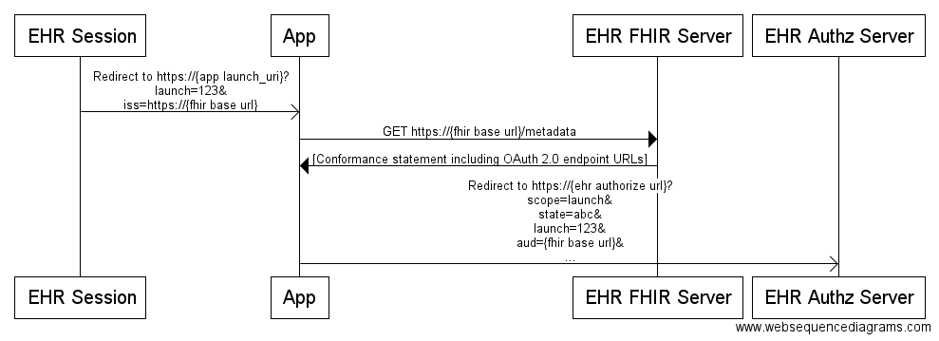
Modified Design
SMART Launch Sequence
http://docs.smarthealthit.org/authorization/

Slide 10
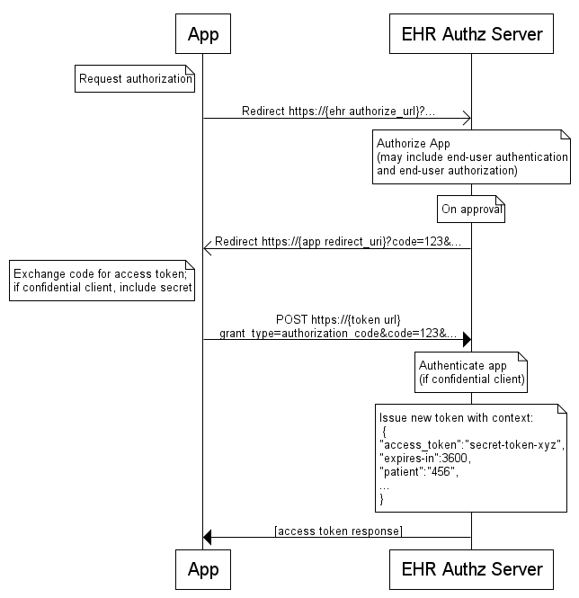
Modified Design
SMART Authorization Sequence
http://docs.smarthealthit.org/authorization/

Slide 11
Modified Design
Deploy Strategy
Requirement to be a Java Web App
Currently deployed on a personal AWS instance
Utilizing standard libraries and HAPI FHIR library to maximize portability
Hand-off document to replace client/secret keys once final app team is established

Slide 12
Value Drivers
Functionality
A web-based Java application was created
It is able to successfully connect to Cerner’s SMART on FHIR platform
It displays specific resources returned from the Cerner FHIR server
Usability
Post-pivot, the web-based application is very simple
Select a Patient from the dropdown and view the relevant data
One primary concern was the ability to adapt the delivered codebase to an account controlled by the OM’s at some point in the future
Part of the application manual covers this transition in detail

Slide 13
Value Drivers
Design
UI
Very simplistic, a scaffolding upon which to build future efforts
Server-side
Utilizes HAPI FHIR interface to maximize future compatibility and upgrades
Innovation
Unfortunately, the late pivot limited our ability to innovate
We only had a few weeks to redesign the application, including:
Discarding existing user interface
Changing design pattern to server-based
Changing language to Java

Slide 14
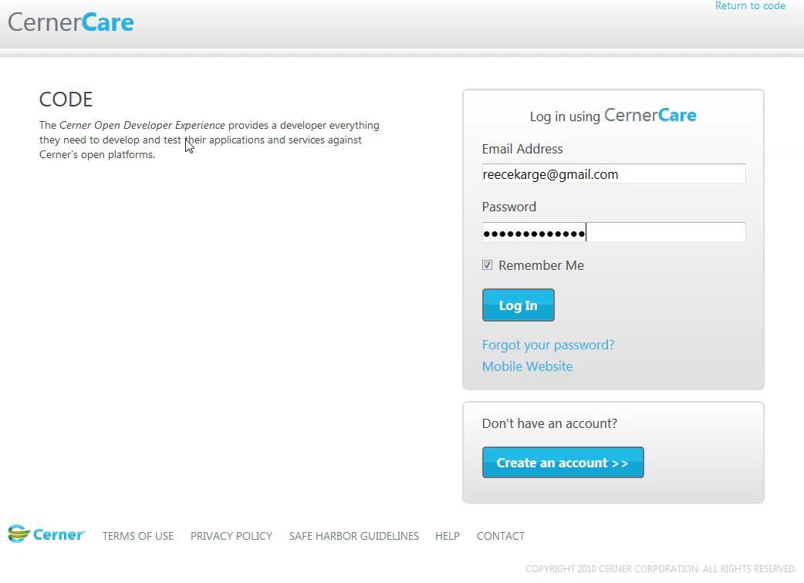
Delivery Walkthrough

Slide 15
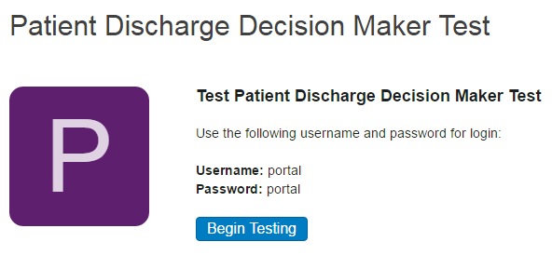
Delivery Walkthrough

Slide 16
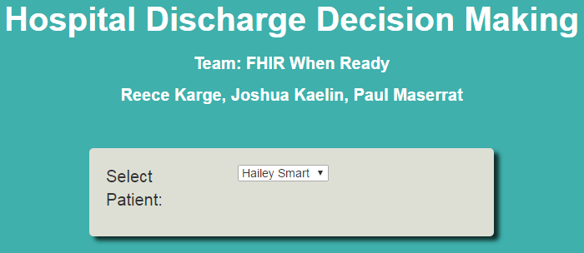
Delivery Walkthrough

Slide 17
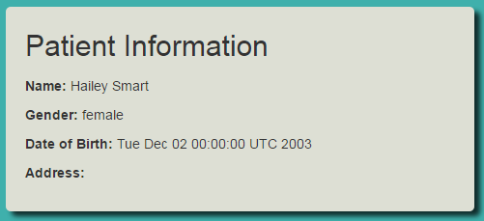
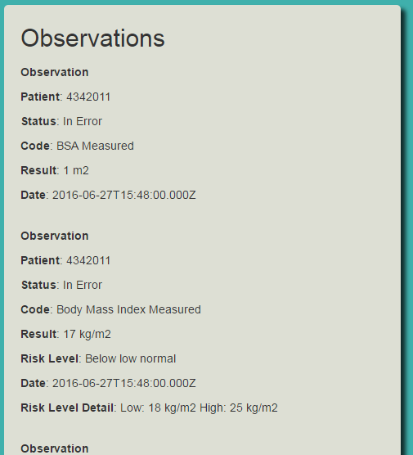
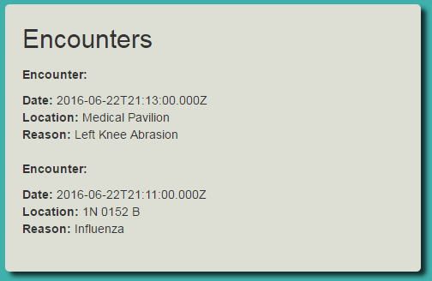
Delivery Walkthrough

